Slide 1
Relational Algebra
Basic Conceptions
Set Operations
Projection
Selection
Cartesian Product
Natural Join
Theta Join
Renaming
Division
Combining Operations
Constraints on Relations
Summary

Slide 2
Basic Conceptions
Relational Algebra: which is a kind of query operators that studies the question of database queries from an abstract point of view.
In relational algebra, the operand in the expression is relation, which is represented by its name.
We can then build progressively more complex expressions by applying any of the operators to be described below, either to relations or to simpler expressions of relational algebra.
A query is an expression of relational algebra.

Slide 3
Basic Conceptions
The operations of relational algebra fall into four broad classes:
The usual set operations: ∪(union), − (difference),∩(intersection), ╳ (Cartesian product)
Special operations for a relation: σ(selection), π(projection), θ(theta join), |╳| (natural join), ÷(division)
Logical operator: ∧(and), ∨(or), ┐(not)
Arithmetical comparison operator: >, ≥, <, ≤, =, ≠

Slide 4
Basic Conceptions
Consider the relation R with the schema R(A₁,A₂,……A_{n}), t∈R denotes that t is a tuple of R, t[A_{i}] denotes the component of attribute A_{i} in t.
image set：Consider the relation R with the schema R(X,Y), where X and Y are the sets of attributes.
Let set S be the set of tuples of which their values on X equal to x. The image set of x in R is
the set of the components on Y of tuples in set S,
which can be denoted as Y_{x}={t[Y]|t∈R, t[X]=x}.

Slide 5
1.Set Operations on Relations
set operations: For the two relations R and S,
R∪S: the union of R and S, is the set of elements that are in R or S or both. An element appears only once in the union even if it is present in both R and S.
R∪S={t|t∈R∨t∈S}
R∩S: the intersection of R and S, is the set of elements that are in both R and S.
R∩S={t|t∈R∧t∈S}
R-S: the difference of R and S, is the set of elements that are in R but not in S.
R-S={t|t∈R∧┐t∈S}
Intersection can be expressed in terms of set difference: R∩S=R-(R-S)

Slide 6
Set Operations
Note that R-S is different from S-R, the latter is the set of elements that are in S but not in R.
These three set operations will not change the scheme of the relation.
Can any two relations be operated by set operations?
R and S need to satisfy some conditions:
R and S must have schemas with identical sets of attributes.
The columns of R and S must be ordered so that the order of attributes is the same for both relations (to ensure that the i^{th} attributes of both R and S are with the same type. ).
If we want to take the set operations of relations that have the same number of attributes but use different names for their attributes, we can use the renaming operator to change the schema of one or both relations and give them the same set of attributes.

Slide 7
Set Operations-Example
Suppose that R and S are both the instances of relation MovieStar, the current instances of which are shown below.
name | address | gender | birthdate
Carrie Fisher Mark Hamill | 123 Maple St. Hollywood 456 Oak Rd. Brentwood | F M | 9/9/99 8/8/88
R
name | address | gender | birthdate
Carrie Fisher Harrison Ford | 123 Maple St. Hollywood 678 Palm Dr. Beverly Hills | F M | 9/9/99 7/7/77
S
name | address | gender | birthdate
Carrie Fisher Mark Hamill Harrison Ford | 123 Maple St. Hollywood 456 Oak Rd. Brentwood 678 Palm Dr. Beverly Hills | F M M | 9/9/99 8/8/88 7/7/77
R∪S
name | address | gender | birthdate
Carrie Fisher | 123 Maple St. Hollywood | F | 9/9/99
R∩S

Slide 8
Set Operations-Example
name | address | gender | birthdate
Carrie Fisher Mark Hamill | 123 Maple St. Hollywood 456 Oak Rd. Brentwood | F M | 9/9/99 8/8/88
R
name | address | gender | birthdate
Carrie Fisher Harrison Ford | 123 Maple St. Hollywood 678 Palm Dr. Beverly Hills | F M | 9/9/99 7/7/77
S
R−S
name | address | gender | birthdate
Mark Hamill | 456 Oak Rd. Brentwood | M | 8/8/88
S−R
name | address | gender | birthdate
Harrison Ford | 678 Palm Dr. Beverly Hills | M | 7/7/77

Slide 9
Set Operations-Example-SELECT
R∪S
SELECT * FROM R
UNION
SELECT * FROM S
SELECT * FROM R
INTERSECT
SELECT * FROM S
SELECT * FROM R
EXCEPT
SELECT * FROM S
R∩S
R−S

Slide 10
2. Projection
The projection operator is used to produce from a relation R a new relation that has only some of R’s columns, which can be expressed as:
π_{A1,A2,…An}(R)={t[A₁,A₂,…A_{n}]|t∈R}
The schema for the resulting value is the set of attributes {A₁,A₂,…,A_{n}}, which is shown in the order listed.
It will be recorded only once for the tuples that have the same value in their component for each attribute.
The projection operator can be used to change the order of the attributes.

Slide 11
Projection-Example
【e.g.】Consider the relation Movie, we can project this relation onto the first three attributes:
title | year | length | inColor | studioName | produc#
Star Wars Mighty Ducks Wayne’s World | 1977 1991 1992 | 124 104 95 | true true true | Fox Disney Paramount | 11111 22222 33333
The resulting relation is:
title | year | length
Star Wars Mighty Ducks Wayne’s World | 1977 1991 1992 | 124 104 95
SELECT DISTINCT title,year,length
FROM Movie

Slide 12
3. Selection
The selection operator, applied to a relation R, produces a view relation with a subset of R’s tuples. The tuples in the resulting relation are those that satisfy some condition C that involves the attributes of R,
we denote this operationσ_{C}(R).
σ_{C}(R)={t | t∈R∧( C(t) is satisfied.) }
The resulting relation keep the same order of attributes with R.
C is a conditional expression consisting of the operands and the operators.
The operands in C are either constants or attributes of R.
The operators can be the arithmetical comparison operator (>, ≥, <, ≤, =, ≠) and the logical operator (∧, ∨, ┐).
The result of C is either “TURE” or “FALSE”.

Slide 13
Selection
For σ_{C}(R),
How to check the condition C and calculate the result?
Apply C to each tuple t of R by substituting, for each attribute A appearing in condition C, the component of t for attribute A.
If after substituting for each attribute of C the condition C is true, then t is one of the tuples that appear in the resulting σ_{C}(R), otherwise, t is not in the result.
title | year | length | inColor | studioName | produc#
Star Wars Mighty Ducks Wayne’s World | 1977 1991 1992 | 124 104 95 | true true true | Fox Disney Paramount | 11111 22222 33333
Query for those films’ information of which the length is not less than 100 minutes.

Slide 14
Selection-Example
title | year | length | inColor | studioName | produc#
Star Wars Mighty Ducks | 1977 1991 | 124 104 | true true | Fox Disney | 11111 22222
single quotation marks
title | year | length | inColor | studioName | produc#
Star Wars | 1977 | 124 | true | Fox | 11111
SELECT * FROM Movie
WHERE length>=100
SELECT * FROM Movie
WHERE length>=100 AND studioName='Fox'

Slide 15
4.Cartesian Product
◆The Cartesian product (or just product) of two sets R and S is the set of pairs that can be formed by choosing the first element of the pair to be any element of R and the second an element of S. This product is denoted R╳S.
The relation schema for the resulting relation is the union of the schemas for R and S. The components from R precede the components from S in the order of the expression R╳S.
If R has k₁ tuples and S has k₂ tuples, then the resulting relation of Cartesian product has k₁*k₂ tuples.
If R and S have some attributes in common, then we need to invent new names for at least one of each pair of identical attributes.
To disambiguate an attribute A that is in the schemas of both R and S, use R.A for the attribute from R and S.A for the attribute from S.

Slide 16
Product-Example
【e.g.】Let relations R and S have the schemas and tuples shown in the following figures. Then the product R╳S consists of the six tuples.
R
S
A | R.B | S.B | C | D
1 1 1 3 3 3 | 2 2 2 4 4 4 | 2 4 9 2 4 9 | 5 7 10 5 7 10 | 6 8 11 6 8 11
A | B
1 3 | 2 4
B | C | D
2 4 9 | 5 7 10 | 6 8 11
SELECT * FROM R,S
SELECT * FROM R CROSS JOIN S

Slide 17
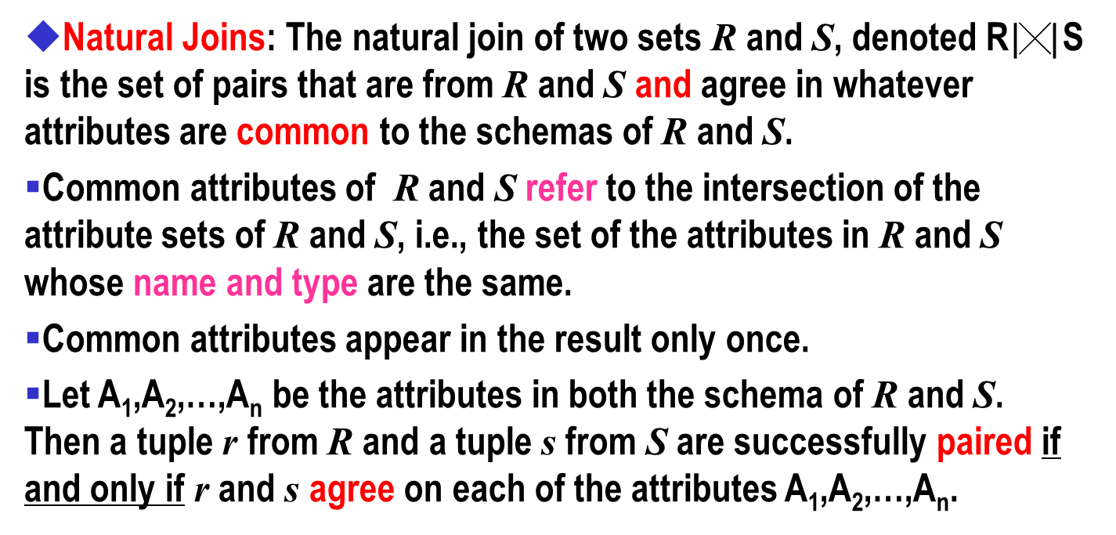
5. Natural Joins
Natural Joins: The natural join of two sets R and S, denoted R$|╳|$ S is the set of pairs that are from R and S and agree in whatever attributes are common to the schemas of R and S.
Common attributes of R and S refer to the intersection of the attribute sets of R and S, i.e., the set of the attributes in R and S whose name and type are the same.
Common attributes appear in the result only once.
Let A₁,A₂,…,A_{n} be the attributes in both the schema of R and S. Then a tuple r from R and a tuple s from S are successfully paired if and only if r and s agree on each of the attributes A₁,A₂,…,A_{n}.

Slide 18
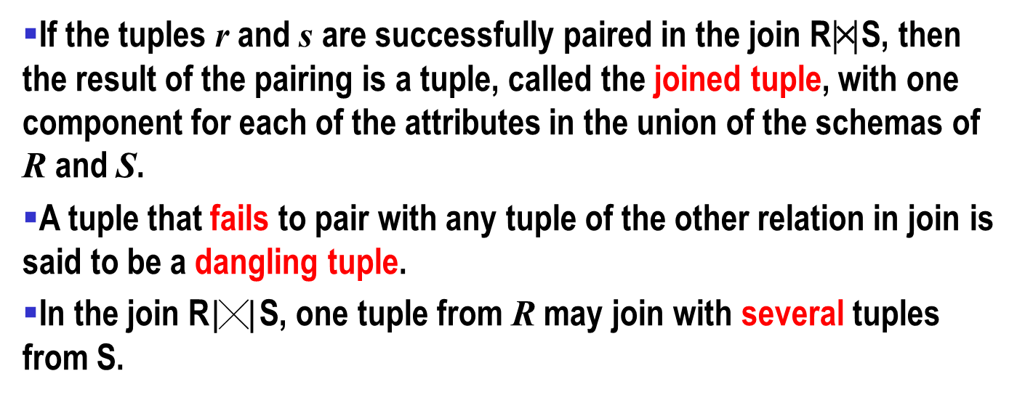
Natural Joins
If the tuples r and s are successfully paired in the join R|╳| S, then the result of the pairing is a tuple, called the joined tuple, with one component for each of the attributes in the union of the schemas of R and S.
A tuple that fails to pair with any tuple of the other relation in join is said to be a dangling tuple.
In the join R$|╳|$ S, one tuple from R may join with several tuples from S.

Slide 19

Natural Joins-Example
A | B
1 3 | 2 4
B | C | D
2 4 9 | 5 7 10 | 6 8 11
A | B | C | D
1 3 | 2 4 | 5 7 | 6 8
=
A | B | C
1 6 9 | 2 7 7 | 3 8 8
B | C | D
2 2 7 | 3 3 8 | 4 5 10
A | B | C | D
1 1 6 9 | 2 2 7 7 | 3 3 8 8 | 4 5 10 10
=
Relation U
Relation V

Slide 20
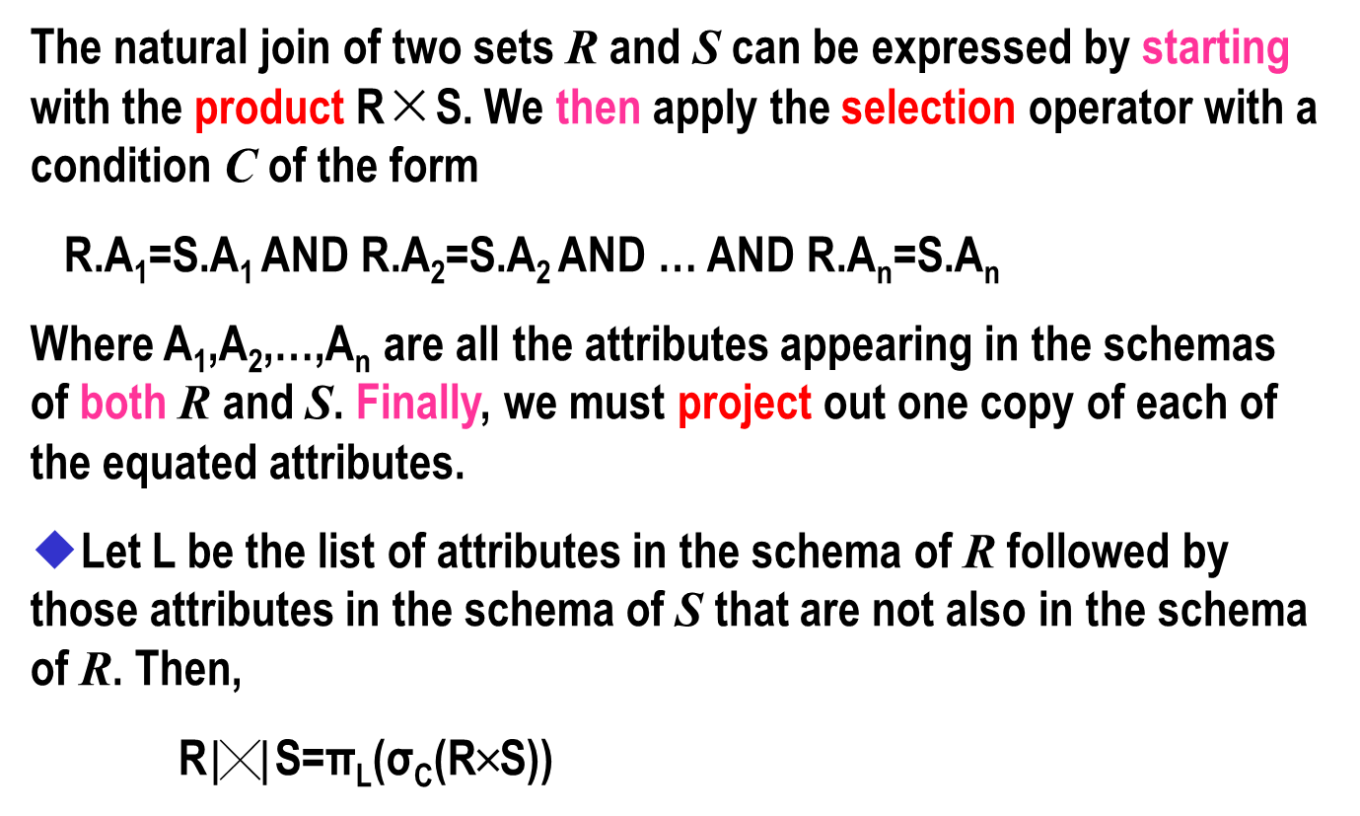
Natural Joins
The natural join of two sets R and S can be expressed by starting with the product R×S. We then apply the selection operator with a condition C of the form
R.A₁=S.A₁ AND R.A₂=S.A₂ AND … AND R.A_{n}=S.A_{n}
Where A₁,A₂,…,A_{n} are all the attributes appearing in the schemas of both R and S. Finally, we must project out one copy of each of the equated attributes.
◆Let L be the list of attributes in the schema of R followed by those attributes in the schema of S that are not also in the schema of R. Then,
R$|╳|$ S=π_{L}(σ_{C}(R╳S))

Slide 21
Natural Joins
A | B | C
1 6 9 | 2 7 7 | 3 8 8
B | C | D
2 7 7 | 3 3 8 | 4 5 10
SELECT A, U.B, U.C, D
FROM U INNER JOIN V ON U.B=V.B AND U.C=V.C
Relation U
Relation V
The natural join of the relations U and V can be written in terms of product, selection, and projection as
π_{A,U.B,U.C,D}(σ_{(U.B=V.B)∧(U.C=V.C)}(U╳V))，
That is, we take the product U╳V, then we select for equality between each pair of attributes with the same name (B and C in this example). Finally, we project onto all the attributes except one of the B’s and one of the C’s. we have to chosen to eliminate the attributes of V whose names also appear in the schema of U.

Slide 22
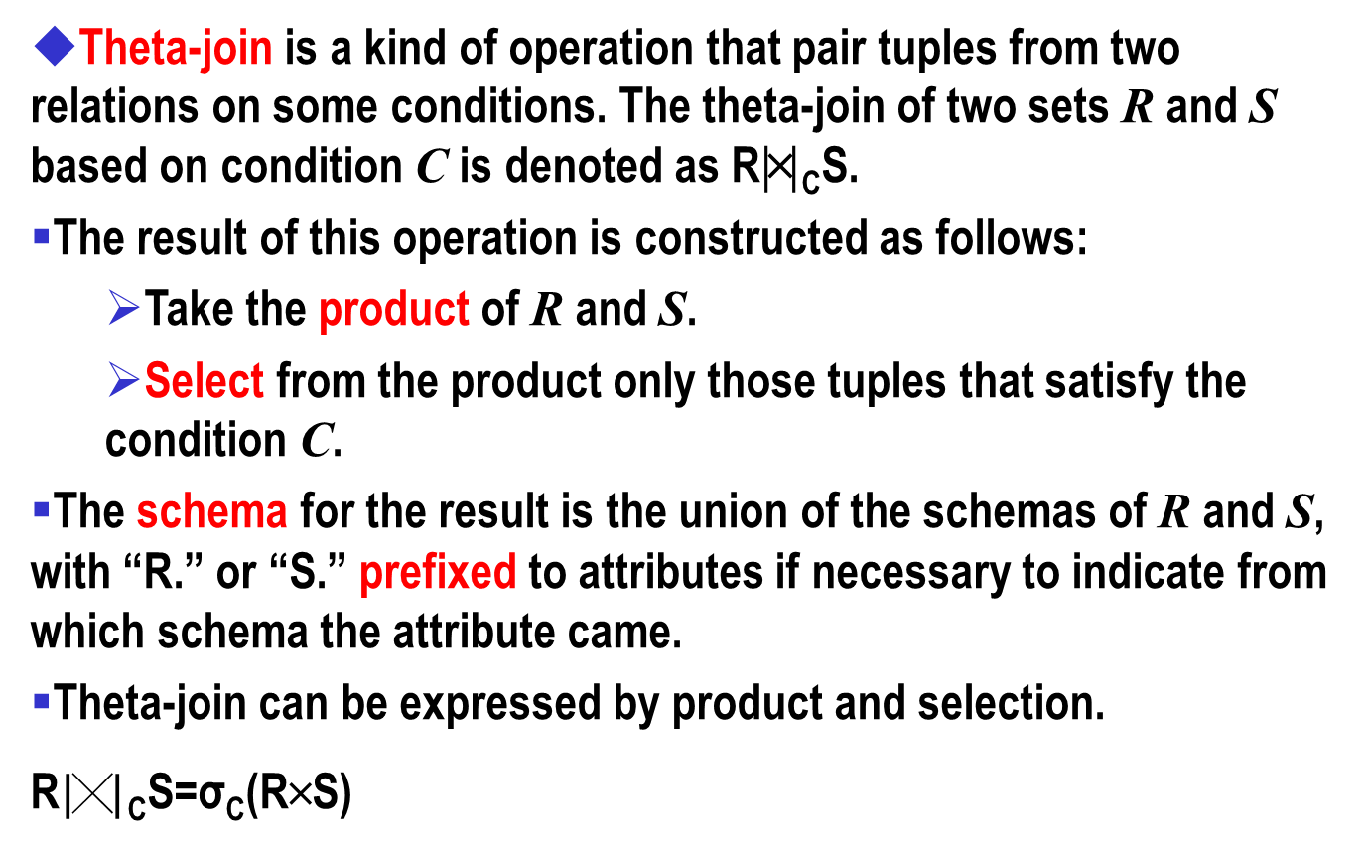
6. Theta-Joins
Theta-join is a kind of operation that pair tuples from two relations on some conditions. The theta-join of two sets R and S based on condition C is denoted as R|╳| _{C}S.
The result of this operation is constructed as follows:
Take the product of R and S.
Select from the product only those tuples that satisfy the condition C.
The schema for the result is the union of the schemas of R and S, with “R.” or “S.” prefixed to attributes if necessary to indicate from which schema the attribute came.
Theta-join can be expressed by product and selection.
R$|╳|$ _{C}S=σ_{C}(R╳S)

Slide 23

θ join-Example
A | U.B | U.C | V.B | V.C | D
1 1 1 6 9 | 2 2 2 7 7 | 3 3 3 8 8 | 2 2 7 7 7 | 3 3 8 8 8 | 4 5 10 10 10
A | B | C
1 6 9 | 2 7 7 | 3 8 8
B | C | D
2 2 7 | 3 3 8 | 4 5 10
=
U$|╳|$ _{A<D}V
The schema for the result consists of all six attributes, with U and V prefixed to their respective occurrences of attributes B and C to distinguish them.
If the condition is that all the common attributes have the same values in theta-join, is it the same with natural join?
◆No. In the natural join, common attributes are merged into one copy.

Slide 24

θ join-Example
U$|╳|$_{(A<D)∧(U.B≠V.B)}V
A | U.B | U.C | V.B | V.C | D
1 1 1 6 6 6 9 9 9 | 2 2 2 7 7 7 7 7 7 | 3 3 3 8 8 8 8 8 8 | 2 2 7 2 2 7 2 2 7 | 3 3 8 3 3 8 3 3 8 | 4 5 10 4 5 10 4 5 10
A | B | C
1 6 9 | 2 7 7 | 3 8 8
B | C | D
2 2 7 | 3 3 8 | 4 5 10
Relation U
Relation V
σ_{A<D ∧ U.B≠V.B}(U╳V)
A | U.B | U.C | V.B | V.C | D
1 | 2 | 3 | 7 | 8 | 10
SELECT A, U.B, U.C, V.B, V.C, D
FROM U INNER JOIN V ON A<D AND U.B<>V.B

Slide 25
7. Renaming
Renaming: The operator ρ_{S(A1,A2,…,An)}(R) can rename the relation R.
The resulting relation has exactly the same tuples as R, but the name of the relation is S. Moreover, the attributes of the result relation S are named A₁,A₂,…,A_{n}, in order from the left.
If we only want to change the name of the relation to S and leave the attributes as they are in R, we can use ρ_{S}(R).
【e.g.】R╳ρ_{S(X,C,D)}(S).
A | B | X | C | D
1 1 1 3 3 3 | 2 2 2 4 4 4 | 2 4 9 2 4 9 | 5 7 10 5 7 10 | 6 8 11 6 8 11
A | B
1 3 | 2 4
B | C | D
2 4 9 | 5 7 10 | 6 8 11
X | C | D
2 4 9 | 5 7 10 | 6 8 11
Relation R
Relation S

Slide 26
8. Division
Division: There are relations R(X,Y) and S(Y,Z), where X,Y,Z are the sets of attributes. Y’s in R can have different names with Y’s in S, but they must be with the same type.
The resulting relation P(X) that is obtained by R divided by S is a new relation, which is the projection of R onto X based on the following conditon:
The image set of x (i.e., Y_{x}) contains the set of the projection of S onto Y.
We denote the division as:
R÷S={tr[X] | tr∈R∧π_{y}(S)⊆Y_{x}}
Where Y_{x} is the image set of x in R, x=tr[X], tr[X] denotes the component of attribute X in tr and tr∈R.
Division can be expressed as:
R÷S=π_{x}(R)－π_{x}(π_{x}(R)×π_{y}(S)－R)

Slide 27
Division-Example
A
B
C
D
E
C
D
F
A
B
E
a1
b2
c3
d5
e1
c3
d5
f3
a1
b2
e1
a1
b2
c4
d6
e1
c4
d6
f4
R÷S
a2
b4
c1
d3
e3
S
a3
b5
c2
d8
e4
R

Slide 28
Division-Example
sno | pno
S1 S1 S1 S1 S2 S2 S3 S4 S4 | P1 P2 P3 P4 P1 P2 P2 P2 P4
pno
P2
pno
P2 P4
pno
P1 P2 P4
B1
B2
sno
S1 S2 S3 S4
B3
sno
S1 S4
sno
S1
A
A/B1
A/B2
A/B3

Slide 29
9. Combining Operations to Form Queries
One can construct expressions of relational algebra by applying operators to subexpressions, using parentheses when necessary to indicate grouping of operands.
【e.g.】Consider the relation Movie(title,year,length,filmType,studioName). What are the titles and years of movies made by Fox that are at least 100 minutes long?
【Answer】One way to compute the answer to this query is:
1) Select those Movie tuples that have length≥l00.
2) Select those Movie tuples that have StudioName='Fox'.
3) Compute the intersection of 1) and 2).
4) Project the relation from 3) onto attributes title and year.

Slide 30
Queries-Example
【Answer】One way to compute the answer to this query is:
1) Select those Movie tuples that have length≥l00.
2) Select those Movie tuples that have StudioName='Fox‘.
3) Compute the intersection of 1) and 2).
4) Project the relation from 3) onto attributes title and year.
SELECT DISTINCT title,year FROM Movie
WHERE length>=100 AND studioName='Fox'

Slide 31
Queries-Example
◆One use of the natural join operation is to recombine relations that were decomposed.
【e.g.】Suppose that Movie1 is with schema {title,year,length, filmType,studioName} and Movie2 is with schema {title,year, starName}. Write a relational algebra to answer the query “ Find the stars of movies that are at least 100 minutes long”.
【Answer】First, use the natural join to pair only those tuples that agree on title and year, that is, pairs of tuples that refer to the same movie.
Then apply a selection that enforces the condition that the length of the movie is at least 100 minutes.
Finally, project onto the desired set of attributes: starName.

Slide 32
Queries-Example
SELECT DISTINCT starName FROM Movie1 a INNER JOIN Movie2 b ON a.title=b.title AND a.year=b.year
WHERE length>=100
SELECT DISTINCT starName FROM Movie1 a, Movie2 b
WHERE a.title=b.title AND a.year=b.year AND length>=100
SELECT DISTINCT starName FROM Movie2
WHERE (title,year) IN (SELECT (title,year) FROM Movie1 WHERE length>=100)

Slide 33
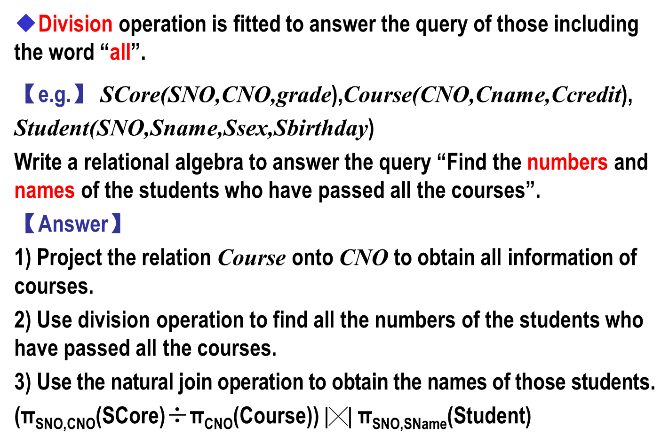
Queries-Example
◆Division operation is fitted to answer the query of those including the word “all”.
【e.g.】 SCore(SNO,CNO,grade),Course(CNO,Cname,Ccredit),
Student(SNO,Sname,Ssex,Sbirthday)
Write a relational algebra to answer the query “Find the numbers and names of the students who have passed all the courses”.
【Answer】
1) Project the relation Course onto CNO to obtain all information of courses.
2) Use division operation to find all the numbers of the students who have passed all the courses.
3) Use the natural join operation to obtain the names of those students.
(π_{SNO,CNO}(SCore)÷π_{CNO}(Course))$|╳|$π_{SNO,SName}(Student)

Slide 34
Queries-Example-SELECT
SELECT sno,sname
FROM Student
WHERE sno IN (
SELECT sno
FROM Student a, (SELECT Count(cno) AS cnt FROM Course) b
WHERE (SELECT Count(cno) FROM Score WHERE sno=a.sno)=b.cnt )
SELECT sno,sname
FROM Student
WHERE sno IN (
SELECT sno
FROM Student a
WHERE (SELECT Count(cno) FROM Score WHERE sno=a.sno)
= (SELECT Count(cno) FROM Course) )

Slide 35
Queries-Example-SELECT
SELECT b.sno,sname
FROM (SELECT DISTINCT sno
FROM score c, (SELECT Count(cno) AS cnt FROM Course) d
WHERE (SELECT COUNT (cno) FROM Score WHERE sno=c.sno)=d.cnt
)AS a
INNER JOIN
(SELECT sno,sname FROM Student)AS b
ON a.sno=b.sno

Slide 36
Notation
1. 问题要求回答的内容才要显示，其他内容不能有。别忘了用投影显示要查询的属性。
2. 笛卡尔积、自然连接和θ连接要分清。
笛卡尔积是两个关系的元组的排列组合，没有任何条件。
自然连接要求元组中相同属性有相同的值。
θ连接是在做了笛卡尔积之后再选择符合条件的组合。
3. 复杂的查询可以首先将它分解成一步一步的简单的查询。

Slide 37
Execises-1
【e.g.】Suppose that there exist the following two relations. Write relational algebras to answer the following queries:
Product( maker, model, producttype)
PC( model, speed, ram, hd, cd, price)
1. Find the model of PC whose speed is at least 150.
2. Find the model, speed and price of PC and their maker.
3. Find the maker of PC whose price is higher than 1000.
4. Find the model of PC whose speed is greater than 133 or whose ram is greater than 256.

Slide 38

Execises-2
【e.g.】 Suppose that there exist the following four relations. Write relational algebras to answer the following queries:
Product( maker, model, producttype)
PC( model, speed, ram, hd, cd, price)
Laptop( model, speed, ram, hd, screen, price)
Printer( model, color, type, price)
1. Find the hd that appears in more than two different PCs.
【Answer】R1=ρ_{PC1}(PC)
R2=ρ_{PC2}(PC)
R3=R1 $|╳|$ PC1.hd=PC2.hd∧PC1.model≠PC2.modelR2
SELECT DISTINCT PC1.hd FROM PC PC1, PC PC2
WHERE PC1.hd=PC2.hd AND PC1.model<>PC2.model

Slide 39
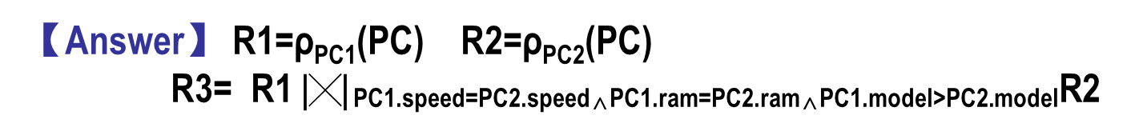
Execises-2
【e.g.】 Suppose that there exist the following four relations. Write relational algebras to answer the following queries:
Product( maker, model, producttype)
PC( model, speed, ram, hd, cd, price)
Laptop( model, speed, ram, hd, screen, price)
Printer( model, color, type, price)
2. Find the pairs of PC model whose speed and ram agree with each other respectively.
【Answer】 R1=ρ_{PC1}(PC) R2=ρ_{PC2}(PC)
R3= R1 $|╳|$PC1.speed=PC2.speed∧PC1.ram=PC2.ram∧PC1.model>PC2.modelR2
SELECT PC1.model,PC2.model FROM PC PC1, PC PC2
WHERE PC1.speed=PC2.speed AND PC1.ram=PC2.ram AND PC1.model>PC2.model

Slide 40
Execises-2
【e.g.】 Suppose that there exist the following four relations. Write relational algebras to answer the following queries:
Product( maker, model, producttype)
PC( model, speed, ram, hd, cd, price)
Laptop( model, speed, ram, hd, screen, price)
Printer( model, color, type, price)
3. Find the maker that produces at least two types of computers and the speed of computers is not less than 133.
【Answer】

Slide 41
10. Constraints on Relations
If R and S are expression of relational algebra, then
R=Ø is a constraint that says “The value of R must be empty”, or equivalently “there are no tuples in the result of R”.
R S is a constraint that says “every tuple in the result of R must also be in the result of S”. Of course the result of S may contain additional tuples not produced by R.
The constraint R S can be written as R-S=Ø, R=Ø can also be written as R Ø. Notice that R-R=Ø.
Referential Integrity Constraint: If an object or entity A is related to object or entity B, then B must really exist.
In the relational model, if there is a value v for a component of a tuple in one relation R, then because of the design intentions, we may expect that v will appear in a particular component of some tuple of another relation S.

Slide 42
Constraints-Example
【e.g.】 Consider the two relations
Movie(title,year,length,filmType,studioName,producerC#)
MovieProducer (name,address,cert#,netWorth)
We might reasonably assume that the producer of every movie would have to appear in the MovieProducer relation.
To be more precise, the producerC# component of each Movie tuple must also appear in the cert# component of some MovieProducer tuple.
This constraint can be expressed by the set-containment:

Slide 43
Constraints-Example
It can be similarly expressed if in a referential integrity constraint, the value involved is represented by more than one attribute.
【e.g.】 For instance, we may want to assert that any movie mentioned in the relation
starsIn(movieTitle,movieYear,starName)
also appears in the relation
Movie(title,year,length,inColor,studioName,producerC#)
Movies are represented in both relations by title-year pairs, because we agree that one of these attributes alone was not sufficient to identify a movie. The following constraint expresses this referential integrity constraint:
Pay attention to the list of components.

Slide 44
Additional Constraint
Additional Constraint:
A domain constraint requires that values for an attribute have a specific data type, such as integer or character string of length 30.
A domain constraint often involves specific values that we require for an attribute. If the set of acceptable values can be expressed in the language of selection conditions, then this domain constraint can be expressed in the algebraic constraint language.
【e.g.】Suppose we wish to specify that the only legal values for the gender attribute of MovieStar are ‘F’和‘M’. This constraint can be expressed by

Slide 45
Constraints-Example
【e.g.】For the relations MovieExec(name,address,cert#,netWorth) and Studio(name,address,presC#), suppose we wish to require that one must have a net worth of at least $10000000 to be the president of a movie studio. Please express this constraint in the algebraic constraint language.
First we need to theta-join the two relations using the condition that presC# from Studio and cert# from MovieExec are equal. That join combines pairs of tuples consisting of a studio and an executive.
If we select from this relation those tuples where the net worth is less than $10000000, the set must be empty. So the constraint can be expressed as:

Slide 46
Summary
1. 并R∪S、交R∩S、差R-S。
2. 投影 从关系R产生一个只有R的某些列的新关系。
3. 选择 σ_{C}(R)保留满足条件C的R中的元组。
4. 笛卡尔积 R╳S是两个关系R和S的元素对的集合。
5. 自然连接 R|╳|S，结果关系的元组是R和S元组在公共属性上取值一致的所有元组的组合。
6. θ连接 R|╳|_{C}S，结果关系是首先获得R和S的积(笛卡尔积)，然后从乘积中选择满足条件C的元组。
7. 改名 ρ_{s}(A₁,A₂,…,A_{n})(R)，结果关系名是S，属性从左至右依次命名为A₁,A₂,…,A_{n}。
8. 除法R÷S是R中满足下列条件的元组在X上的投影：元组在X上分量值x的象集Yx包含S在Y上投影的集合。

